Slide 1
Node.js Everywhere
Mikeal Rogers (@mikeal)
Node.js Foundation

Slide 2
Node.js is the fastest growing open source platform in the world.

Slide 3
Module Counts

Slide 4
More than 400 new packages are published to npm everyday.
Modulecounts.com

Slide 5
Node.js Growth and Adoption
Node.js has an estimated 3.5M users and is consistently growing at 100% per year.

Slide 6



The New Full Stack
Web Frontend
Mobile & Tablets
Desktop
API Services
IoT
Devices
Cloud Backend

Slide 7


Web Frontend Development

Slide 8








Web Frontend Development

Slide 9


Mobile Development
Web Frontend Development

Slide 10





Mobile Development

Slide 11


Mobile Development
Desktop Development

Slide 12




Desktop Development

Slide 13
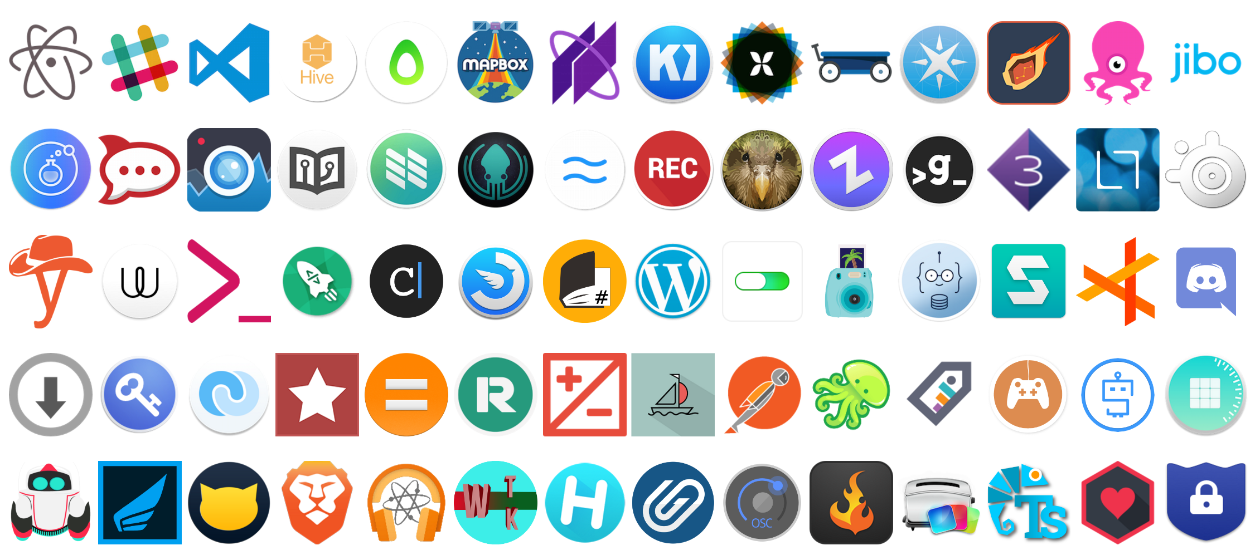
Desktop Development

Slide 14


Desktop Development
Cloud Services

Slide 15







Cloud Services

Slide 16


IoT Devices
Cloud Services

Slide 17



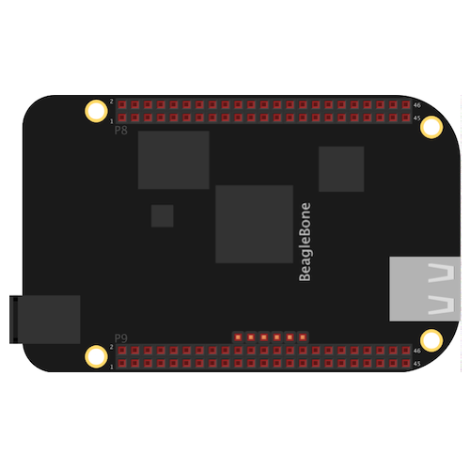

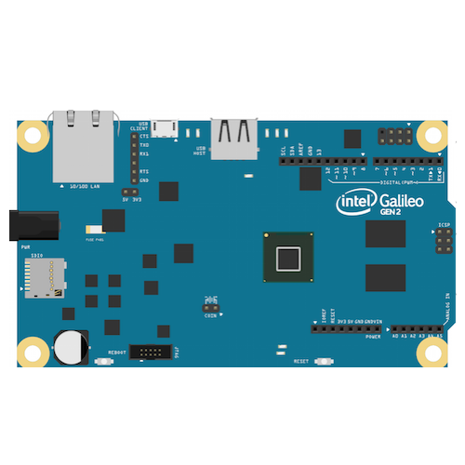

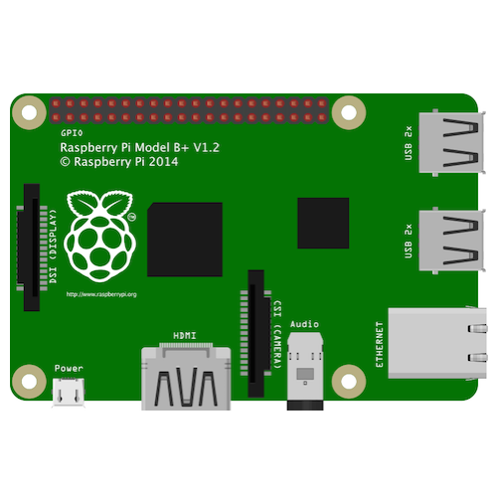

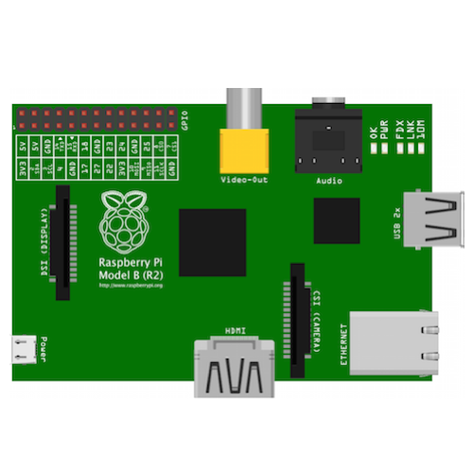
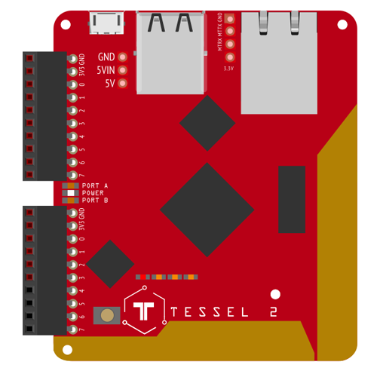
IoT Devices

Slide 18


IoT Devices
APIs & Micro-services

Slide 19
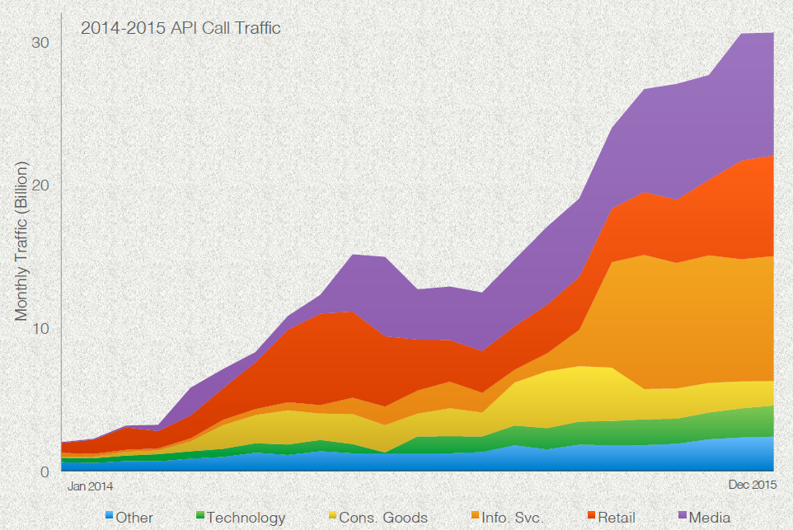
APIs & Micro-services
Source: Programmable Web
Source: Apigee, The State of APIs 2016

Slide 20




APIs & Micro-services

Slide 21


